Slide 1



LARANA, INC.
GAMETRACK
DATA INFORMATION

Slide 2

Overview
One-to-Many relationships:
UserHistory: One user can have multiple interactions (posts and comments).
UserPairing: One user can have multiple pairings with other users.
Interaction: One user can have multiple interactions (posts and comments).
Friendship: One user can have multiple friendships.
Feedback: One user can provide multiple feedback entries.
GamePlay: One user can play multiple games.
Flag: One user can flag multiple posts/comments.
SystemActivityLog: One user can have multiple activity logs.
Many-to-One Relationships:
DirectMessage: Many messages can be sent by one user.

Slide 3
RELATIONSHIPS
GAME
One-to-Many relationships:
UserPairing: One game can be paired with multiple users.
GamePlay: One game can have multiple gameplay entries.
Posts: One game can have multiple posts related to it.
IGDB: One game can have multiple entries in the IGDB.
UserHistory
Many-to-One relationship with User: Many interactions belong to one user.
DirectMessage
Many-to-One relationship with User: Many messages belong to one sender and one receiver.

Slide 4
RELATIONSHIPS
INTERACTION
Many-to-One relationships
User: Many interactions belong to one user.
IGDB: Many interactions are related to one game.
UserPairing
Many-to-One relationship
User: Many pairings belong to one user.
UserSearch
Many-to-One relationship
User: Many search results belong to one user.
Friendship
Many-to-Many relationship
User: Many users can be friends with many other users.

Slide 5
RELATIONSHIPS
Feedback
Many-to-One relationship
User: Many feedback entries belong to one user.
GamePlay
Many-to-One relationship
User: Many gameplay entries belong to one user.
Game: Many gameplay entries belong to one game.
Flag
Many-to-One relationship
User: Many flags belong to one user.
Interaction: Many flags belong to one post/comment.
SystemActivityLog
Many-to-One relationship
User: Many activity logs belong to one user.

Slide 6
RELATIONSHIPS
IGDB
One-to-Many relationship
Interaction: One game can have multiple interactions.
Game: One IGDB entry can represent one game.
Comment
Each comment is associated with a specific post, indicating a many-to-one relationship with the Post entity.
Many comments are made by one user, implying a many-to-one relationship with the User entity.
Post
Each post is associated with a specific game, indicating a many-to-one relationship with the Game entity.
Many posts are made by one user, implying a many-to-one relationship with the User entity.

Slide 7
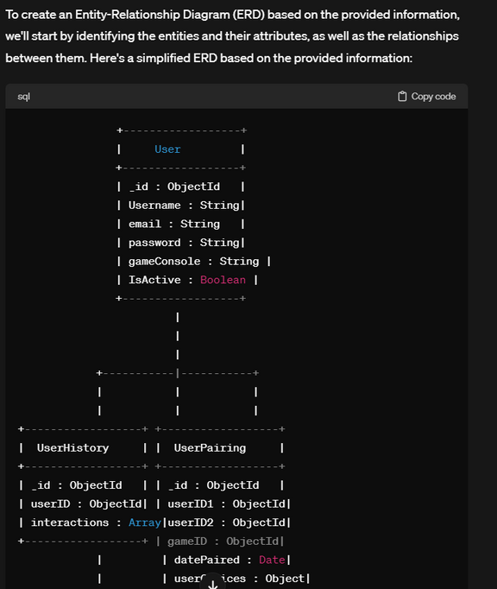
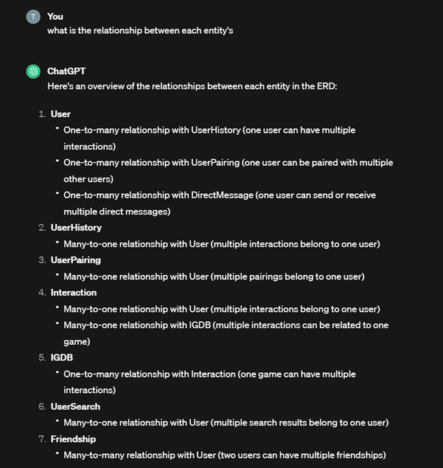
GPT PROMPTS

Slide 8
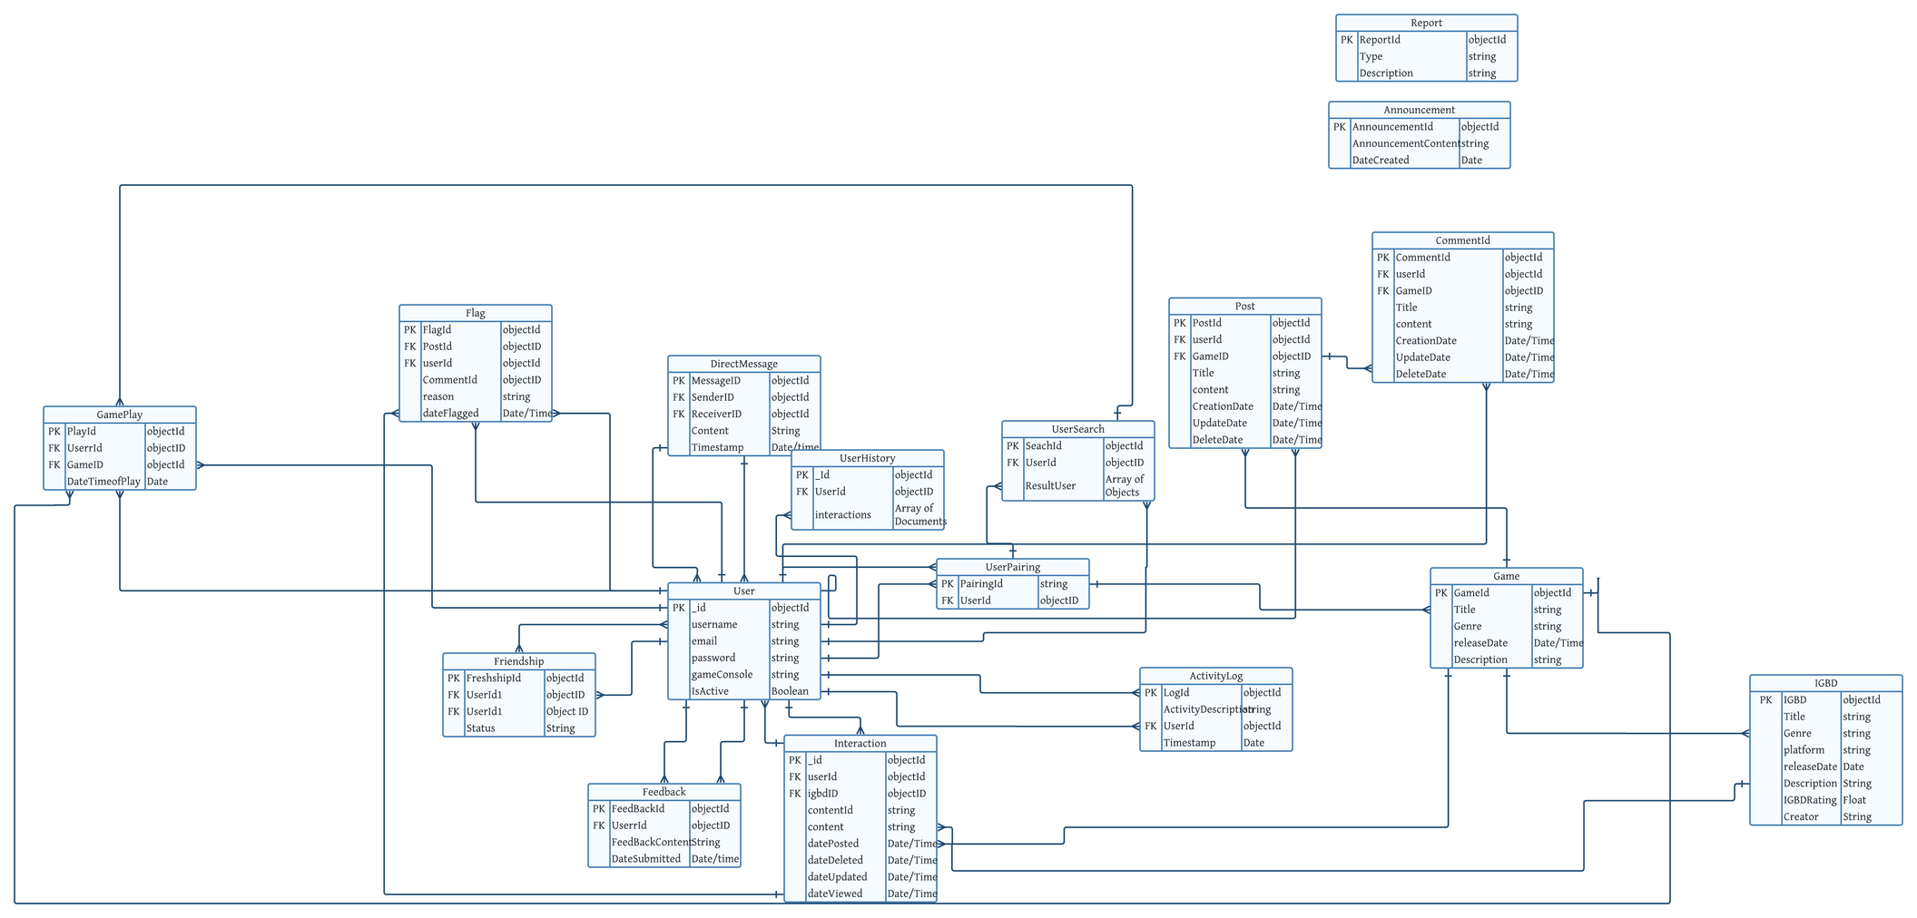

ENTITY RELATIONSHIP DIAGRAM

Slide 9
DICTORNARY
User
FIELD | FIELD TYPE | TYPE | REQUIRED | DESCRIPTION
_ID | OBJECTID | PRIMARY KEY | YES | UNIQUE IDENTIFIER
USERNAME | STRING |  | YES | USER'S USERNAME
EMAIL | STRING |  | YES | USER'S EMAIL
PASSWORD | STRING |  | YES | HASHED PASSWORD
GAMECONSOLE | STRING |  |  | USER'S PREFERRED GAMING CONSOLE
ISACTIVE | BOOLEAN |  |  | USER'S ACTIVE STATUS

Slide 10
DICTORNARY
Game
Field | Field Type | Type | Required | Description
GameID | ObjectId | Primary Key | Yes | Unique identifier
Title | String |  | Yes | Title of the game
Genre | String |  |  | Genre of the game
ReleaseDate | Date |  |  | Release date of the game
Description | String |  |  | Description of the game

Slide 11
DICTORNARY
UserHistory
Field | Field Type | Type | Required | Description
_id | ObjectId | Primary Key | Yes | Unique identifier
userID | ObjectId | Foreign Key (User) | Yes | References User
interactions | Array of Documents |  |  | Array storing user interactions

Slide 12
DICTORNARY
DirectMessage
Field | Field Type | Type | Required | Description
MessageID | ObjectId | Primary Key | Yes | Unique identifier
SenderID | ObjectId | Foreign Key (User) | Yes | References User (Sender)
ReceiverID | ObjectId | Foreign Key (User) | Yes | References User (Receiver)
Content | String |  | Yes | Content of the message
Timestamp | Date |  | Yes | Timestamp of the message

Slide 13
DICTORNARY
Interaction Table
Field | Field Type | Type | Required | Description
_id | ObjectId | Primary Key | Yes | Unique identifier
userID | ObjectId | Foreign Key (User) | Yes | References User
igdbGameID | ObjectId | Foreign Key (Game) | Yes | References Game
contentType | String |  | Yes | Type of interaction (post or comment)
content | String |  | Yes | Content of the post or comment
datePosted | Date |  | Yes | Date when the interaction was posted
dateDeleted | Date |  |  | Date when the interaction was deleted
dateUpdated | Date |  |  | Date when the interaction was updated
dateViewed | Date |  |  | Date when the interaction was viewed

Slide 14
DICTORNARY
UserSearch
Field | Field Type | Type | Required | Description
Searchid | ObjectId | Primary Key | Yes | Unique identifier
UserId | ObjectId | Foreign Key (User) | Yes | References User
ResultUserId | Array of Objects | References User |  | Ids of Users

Slide 15
DICTORNARY
Friendship
Field | Field Type | Type | Required | Description
FriendshipID | ObjectId | Primary Key | Yes | Unique identifier
UserID1 | ObjectId | Foreign Key (User) | Yes | References User (1st User)
UserID2 | ObjectId | Foreign Key (User) | Yes | References User (2nd User)
Status | String |  | Yes | Friendship status

Slide 16
DICTORNARY
Feedback
Field | Field Type | Type | Required | Description
FeedbackID | ObjectId | Primary Key | Yes | Unique identifier
UserID | ObjectId | Foreign Key (User) | Yes | References User
FeedbackContent | String |  |  | Feedback content
DateSubmitted | Date |  |  | Date when the feedback was submitted

Slide 17
DICTORNARY
GamePlay
Field | Field Type | Type | Required | Description
PlayID | ObjectId | Primary Key | Yes | Unique identifier
UserID | ObjectId | Foreign Key (User) | Yes | References User
GameID | ObjectId | Foreign Key (Game) | Yes | References Game
DateTimeOfPlay | Date |  | Yes | Date and time of the gameplay

Slide 18
DICTORNARY
Flag
Field | Field Type | Type | Required | Description
FlagID | ObjectId | Primary Key | Yes | Unique identifier
UserID | ObjectId | Foreign Key (User) | Yes | References User
PostID | ObjectId | Foreign Key (Interaction) |  | References Interaction (Post)
CommentID | ObjectId | Foreign Key (Interaction) |  | References Interaction (Comment)
Reason | String |  |  | Reason for flagging
DateFlagged | Date |  |  | Date when the post/comment was flagged

Slide 19
DICTORNARY
Flag
Field | Field Type | Type | Required | Description
FlagID | ObjectId | Primary Key | Yes | Unique identifier
UserID | ObjectId | Foreign Key (User) | Yes | References User
PostID | ObjectId | Foreign Key (Interaction) |  | References Interaction (Post)
CommentID | ObjectId | Foreign Key (Interaction) |  | References Interaction (Comment)
Reason | String |  |  | Reason for flagging
DateFlagged | Date |  |  | Date when the post/comment was flagged

Slide 20
DICTORNARY
Annoucement
Field | Field Type | Type | Required | Description
AnnouncementID | ObjectId | Primary Key | Yes | Unique identifier
AnnouncementContent | String |  | Yes | Content of the announcement
DateCreated | Date |  | Yes | Date when the announcement was created

Slide 21
DICTORNARY
SystemActivityLog
Field | Field Type | Type | Required | Description
LogID | ObjectId | Primary Key | Yes | Unique identifier
ActivityDescription | String |  | Yes | Description of the activity
UserID | ObjectId | Foreign Key (User) |  | References User (if applicable)
Timestamp | Date |  | Yes | Timestamp of the activity

Slide 22
DICTORNARY
Report
Field | Field Type | Type | Required | Description
ReportID | ObjectId | Primary Key | Yes | Unique identifier
Type | String |  |  | Type of report
Description | String |  |  | Description of the report

Slide 23
DICTORNARY
IGBD
Field | Field Type | Type | Required | Description
IGDBID | ObjectId | Primary Key | Yes | Unique identifier from IGDB
Title | String |  | Yes | Title of the game
Genre | String |  |  | Genre of the game
Platform | String |  |  | Game platform
ReleaseDate | Date |  |  | Release date of the game
Description | String |  |  | Description of the game
IGDBRating | Float |  |  | IGDB rating
Creator | String |  |  | Game creator/developer

Slide 24
DICTORNARY
Posts
Field | Field Type | Type | Required | Description
PostID | ObjectId | Primary Key | Yes | Unique identifier
UserID | ObjectId | Foreign Key (User) | Yes | References User
GameID | ObjectId | Foreign Key (IGDB) | Yes | References IGDB
Title | String |  | Yes | Post Title
Content | Text |  |  | Post content
CreationDate | Date |  | Yes | Creation date
UpdateDate | Date |  |  | Last update date
DeleteDate | Date |  |  | Deletion date

Slide 25
DICTORNARY
Comment
Field | Field Type | Type | Required | Description
CommentID | ObjectId | Primary Key | Yes | Unique identifier
PostID | ObjectId | Foreign Key (Posts) | Yes | References Posts
UserID | ObjectId | Foreign Key (User) | Yes | References User
Content | Text |  | Yes | Comment content
CreationDate | Date |  | Yes | Creation date
UpdateDate | Date |  |  | Last update date
DeleteDate | Date |  |  | Deletion date

Slide 26
THANK YOU

